Slide 1

BDPA Atlanta

Slide 2
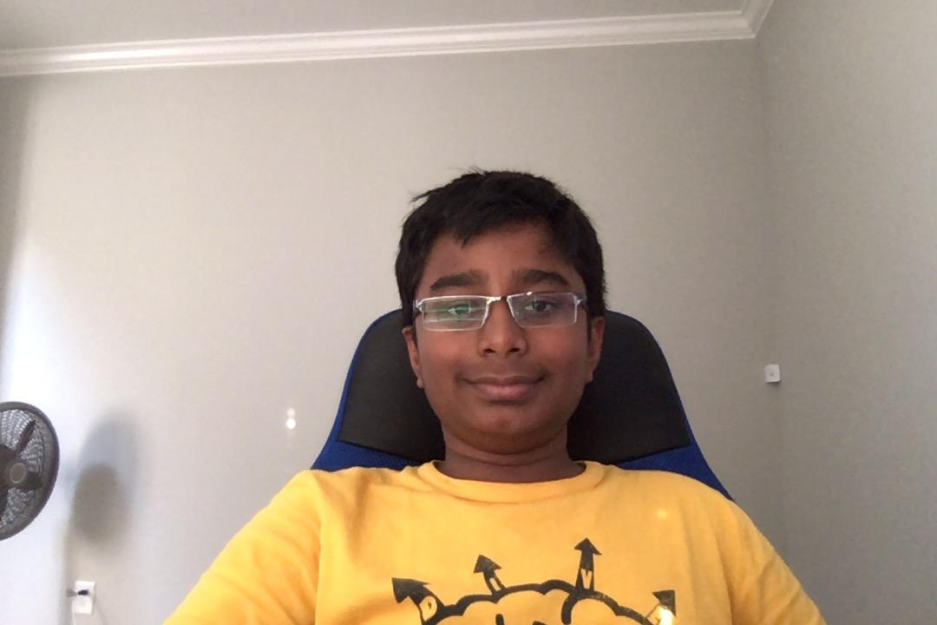
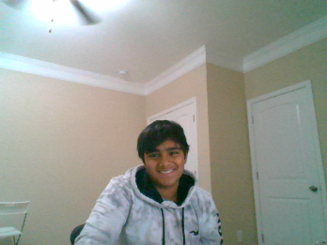
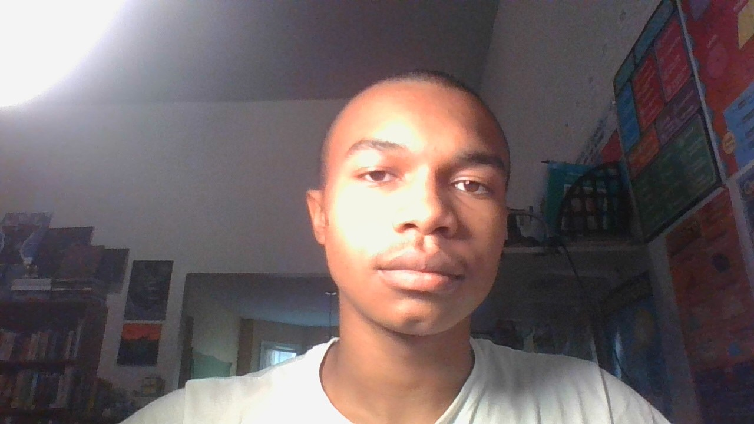
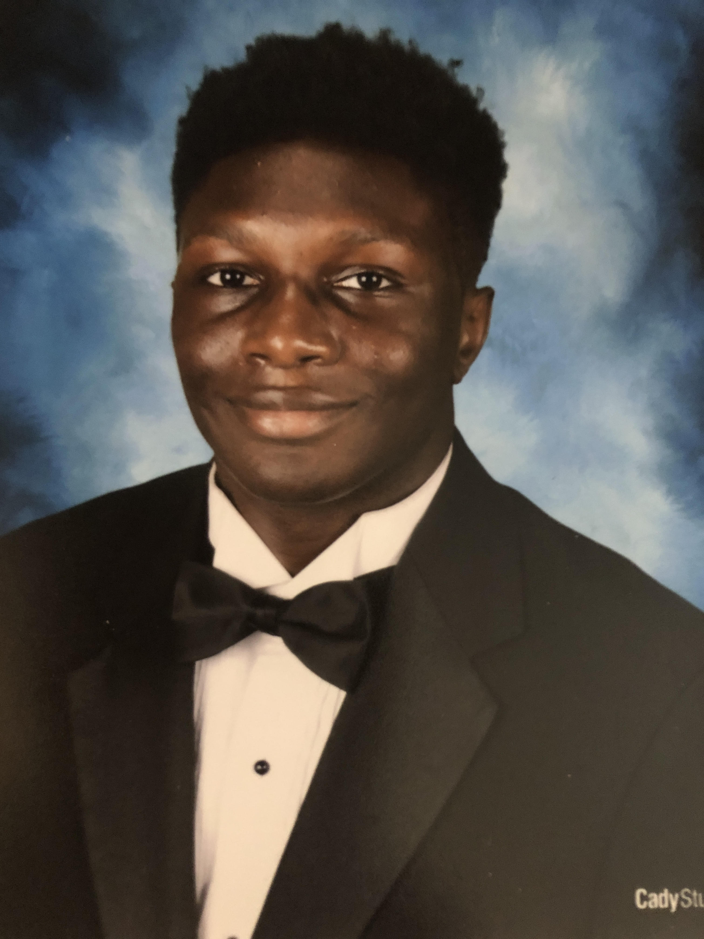
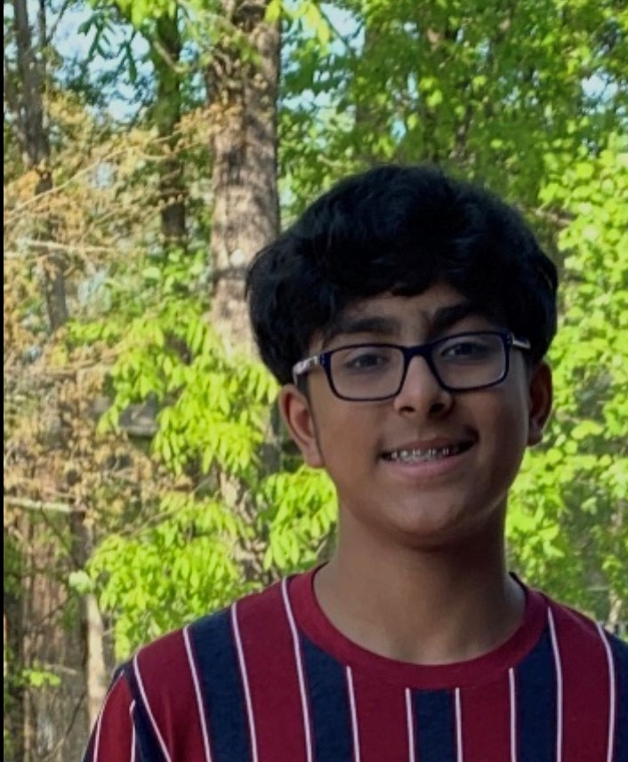
Team Members
Click Me
Suchit Vemula
Abhinav Nama
Saleem Saafir
Kameron Welch
Sowrya Chiluvuri

Slide 3
Sowrya Chiluvuri
Going to Denmark High School
14 years old

Slide 4
Kameron Welch
Graduated From Hillgrove High School 2020
Attending Kennesaw State University Fall of 2020
Majoring in Computer Science
Age: 18 years old

Slide 5
Abhinav Nama
I am a thirteen year old anime lover who likes coding, fingerboarding, guitar,Juice Wrld, and has a knack for comedy . I go to Lakeside Middle and I am in 8th grade.

Slide 6
Suchit Vemula
To go back
Goes to Lakeside Middle School
13 years old

Slide 7
Saleem Saafir
Attends Georgia Connections Academy
16 years old

Slide 8
What we used to set it up
Languages:
Programs:
PHP
JavaScript
MySql
HTML
Bootstrap
Xampp
Atom
Composer
Apache
Github
http://localhost/

